Slide 1
C++ is Fun – Part 10 at Turbine/Warner Bros.!
Russell Hanson

Slide 2
Syllabus
1) First program and introduction to data types and control structures with applications for games learning how to use the programming environment Mar 25-27
2) Objects, encapsulation, abstract data types, data protection and scope April 1-3
3) Basic data structures and how to use them, opening files and performing operations on files – April 8-10
4) Algorithms on data structures, algorithms for specific tasks, simple AI and planning type algorithms, game AI algorithms April 15-17
Project 1 Due – April 17
5) More AI: search, heuristics, optimization, decision trees, supervised/unsupervised learning – April 22-24
6) Game API and/or event-oriented programming, model view controller, map reduce filter – April 29, May 1
7) Basic threads models and some simple databases SQLite May 6-8
8) Graphics programming, shaders, textures, 3D models and rotations May 13-15
Project 2 Due May 15
9) How to download an API and learn how to use functions in that API, Windows Foundation Classes May 20-22
10) Designing and implementing a simple game in C++ May 27-29
11) Selected topics – Gesture recognition & depth controllers like the Microsoft Kinect, Network Programming & TCP/IP, OSC June 3-5
12) Working on student projects - June 10-12
Final project presentations Project 3/Final Project Due June 12

Slide 3
Follow up on App Game Kit
Animations
Buttons
Mouse
Play MP3’s!
Game Physics and kinematic motion

Slide 4
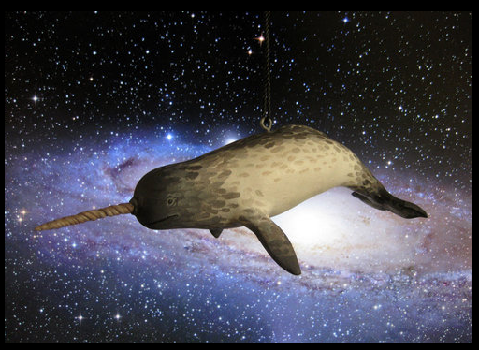
Sample Game
- narwhal tries to escape evil eskimo that wants its tusk
- so it swims so hard that it flies into space!
- that’s level 2
space level
so in space it is trying to dodge space trash
- like old soviet satellites
- and impales them with its HORN

Slide 5
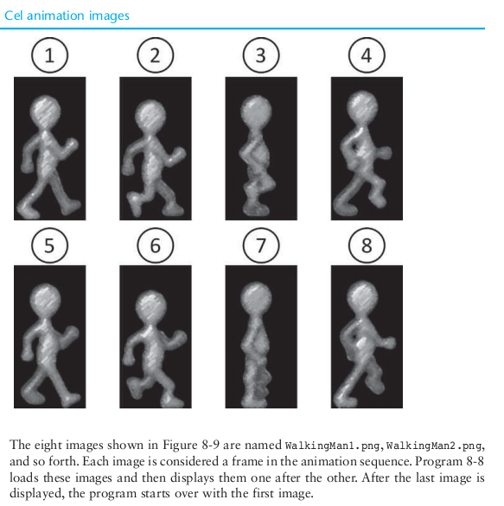
Animations

Slide 6
All materials for the Animations exercise are in the Google Drive in a folder called WalkingMan. 8 .png’s and 1 .cpp file.

Slide 7
// This program demonstrates cel animation.
// Includes, namespace and prototypes
#include "template.h"
using namespace AGK;
app App;
// Constants
const int SCREEN_WIDTH = 640;
const int SCREEN_HEIGHT = 480;
const int FIRST_IMAGE = 1;
const int LAST_IMAGE = 8;
const int SPRITE_INDEX = 1;
const float FPS = 8;
const int MODE = 0;
// Begin app, called once at the start
void app::Begin( void )
{
// Set the window title.
agk::SetWindowTitle("Cel Animation");
// Set the virtual resolution.
agk::SetVirtualResolution(SCREEN_WIDTH, SCREEN_HEIGHT);
// Set the frame rate and mode.
agk::SetSyncRate(FPS, MODE);
// Load the walking man images.
agk::LoadImage(1, "WalkingMan1.png", 1);
agk::LoadImage(2, "WalkingMan2.png", 1);
agk::LoadImage(3, "WalkingMan3.png", 1);
agk::LoadImage(4, "WalkingMan4.png", 1);
agk::LoadImage(5, "WalkingMan5.png", 1);
agk::LoadImage(6, "WalkingMan6.png", 1);
agk::LoadImage(7, "WalkingMan7.png", 1);
agk::LoadImage(8, "WalkingMan8.png", 1);
// Create the sprite using the first frame of animation.
agk::CreateSprite(SPRITE_INDEX, FIRST_IMAGE);
// Calculate the sprite's position.
float spriteWidth = agk::GetSpriteWidth(SPRITE_INDEX);
float spriteHeight = agk::GetSpriteHeight(SPRITE_INDEX);
float spriteX = SCREEN_WIDTH / 2 - spriteWidth / 2;
float spriteY = SCREEN_HEIGHT / 2 - spriteHeight / 2;
// Set the sprite's position.
agk::SetSpritePosition(SPRITE_INDEX, spriteX, spriteY);
}
// Main loop, called every frame
void app::Loop ( void )
{
// Get the sprite's image number.
int currentImage = agk::GetSpriteImageID(SPRITE_INDEX);
// Update the sprite's image number.
if (currentImage == LAST_IMAGE)
{
currentImage = FIRST_IMAGE;
}
else
{
currentImage++;
}
// Set the sprite's image number.
agk::SetSpriteImage(SPRITE_INDEX, currentImage);
// Refresh the screen.
agk::Sync();
}
// Called when the app ends
void app::End ( void )
{
}
// Calculate the sprite's position.
float spriteWidth = agk::GetSpriteWidth(SPRITE_INDEX);
float spriteHeight = agk::GetSpriteHeight(SPRITE_INDEX);
float spriteX = SCREEN_WIDTH / 2 - spriteWidth / 2;
float spriteY = SCREEN_HEIGHT / 2 - spriteHeight / 2;
// Set the sprite's position.
agk::SetSpritePosition(SPRITE_INDEX, spriteX, spriteY);
}
// Main loop, called every frame
void app::Loop ( void )
{
// Get the sprite's image number.
int currentImage = agk::GetSpriteImageID(SPRITE_INDEX);
// Update the sprite's image number.
if (currentImage == LAST_IMAGE)
{
currentImage = FIRST_IMAGE;
}
else
{
currentImage++;
}
// Set the sprite's image number.
agk::SetSpriteImage(SPRITE_INDEX, currentImage);
// Refresh the screen.
agk::Sync();
}
// Called when the app ends
void app::End ( void )
{
}

Slide 8
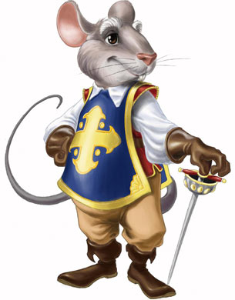
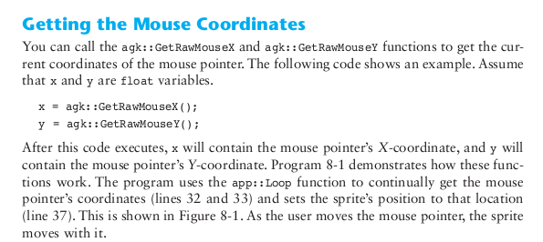
The Mouse aka el raton

Slide 9
Class Exercise:
Mouse.png and cat.png and
MousePress.cpp in gDrive folder
// This program demonstrates pressing
// the left or right mouse buttons.
// Includes, namespace and prototypes
#include "template.h"
using namespace AGK;
app App;
// Begin app, called once at the start
void app::Begin( void )
{
// Set the window title and the virtual resolution.
agk::SetWindowTitle("Mouse Presses");
agk::SetVirtualResolution(agk::GetDeviceWidth(), agk::GetDeviceHeight());
}
// Main loop, called every frame
void app::Loop ( void )
{
// Determine if the left mouse button was pressed.
if(agk::GetRawMouseLeftPressed())
{
// Create a sprite using the "mouse.png" image, and
// set its position to the current mouse coordinates.
agk::SetSpritePosition(agk::CreateSprite("mouse.png"),
agk::GetRawMouseX(),
agk::GetRawMouseY());
}
// Determine if the right mouse button was pressed.
if(agk::GetRawMouseRightPressed())
{
// Create a sprite using the "cat.png" image, and
// set its position to the current mouse coordinates.
agk::SetSpritePosition(agk::CreateSprite("cat.png"),
agk::GetRawMouseX(),
agk::GetRawMouseY());
}
// Refresh the screen.
agk::Sync();
}
// Called when the app ends
void app::End ( void )
{
}

Slide 10
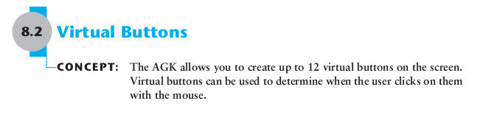
Virtual Buttons

Slide 11
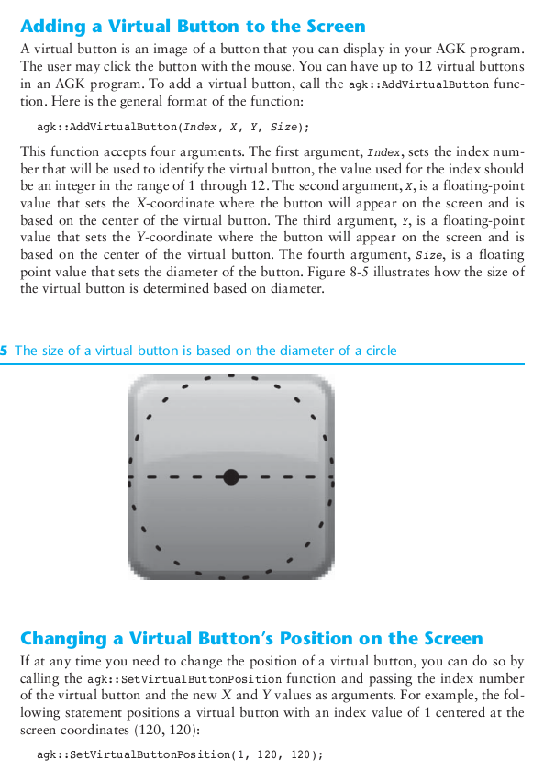

Slide 12
// This program demonstrates virtual buttons.
// Includes, namespace and prototypes
#include "template.h"
using namespace AGK;
app App;
// Constants
const int SCREEN_WIDTH = 640;
const int SCREEN_HEIGHT = 480;
const int SPRITE_INDEX = 1;
const int SHOW_BUTTON_INDEX = 1;
const int HIDE_BUTTON_INDEX = 2;
const float BUTTON_SIZE = 100.0;
// Begin app, called once at the start
void app::Begin( void )
{
// Set the window title.
agk::SetWindowTitle("Virtual Buttons");
// Set the virtual resolution.
agk::SetVirtualResolution(SCREEN_WIDTH, SCREEN_HEIGHT);
// Create the sprite.
agk::CreateSprite(SPRITE_INDEX, "frog.png");
// Calculate the position of the sprite.
float spriteWidth = agk::GetSpriteWidth(SPRITE_INDEX);
float spriteX = SCREEN_WIDTH / 2 - spriteWidth / 2;
float spriteY = 0.0;
// Set the position of the sprite.
agk::SetSpritePosition(SPRITE_INDEX, spriteX, spriteY);
// Calculate the position of the virtual "show" button.
float showButtonX = SCREEN_WIDTH / 2 - BUTTON_SIZE;
float showButtonY = SCREEN_HEIGHT - BUTTON_SIZE;
// Calculate the position of the virtual "hide" button.
float hideButtonX = SCREEN_WIDTH / 2 + BUTTON_SIZE;
float hideButtonY = SCREEN_HEIGHT - BUTTON_SIZE;
// Add the virtual buttons.
agk::AddVirtualButton(SHOW_BUTTON_INDEX, showButtonX,
showButtonY, BUTTON_SIZE);
agk::AddVirtualButton(HIDE_BUTTON_INDEX, hideButtonX,
hideButtonY, BUTTON_SIZE);
// Set the text of the virtual buttons.
agk::SetVirtualButtonText(SHOW_BUTTON_INDEX, "Show");
agk::SetVirtualButtonText(HIDE_BUTTON_INDEX, "Hide");
}
// Main loop, called every frame
void app::Loop ( void )
{
// Determine if the virtual "show" button was pressed.
if(agk::GetVirtualButtonPressed(SHOW_BUTTON_INDEX))
{
// Show the sprite.
agk::SetSpriteVisible(SPRITE_INDEX, 1);
}
// Determine if the virtual "hide" button was pressed.
if(agk::GetVirtualButtonPressed(HIDE_BUTTON_INDEX))
{
// Hide the sprite.
agk::SetSpriteVisible(SPRITE_INDEX, 0);
}
// Refresh the screen.
agk::Sync();
}
// Called when the app ends
void app::End ( void )
{
}
// Add the virtual buttons.
agk::AddVirtualButton(SHOW_BUTTON_INDEX, showButtonX,
showButtonY, BUTTON_SIZE);
agk::AddVirtualButton(HIDE_BUTTON_INDEX, hideButtonX,
hideButtonY, BUTTON_SIZE);
// Set the text of the virtual buttons.
agk::SetVirtualButtonText(SHOW_BUTTON_INDEX, "Show");
agk::SetVirtualButtonText(HIDE_BUTTON_INDEX, "Hide");
}
// Main loop, called every frame
void app::Loop ( void )
{
// Determine if the virtual "show" button was pressed.
if(agk::GetVirtualButtonPressed(SHOW_BUTTON_INDEX))
{
// Show the sprite.
agk::SetSpriteVisible(SPRITE_INDEX, 1);
}
// Determine if the virtual "hide" button was pressed.
if(agk::GetVirtualButtonPressed(HIDE_BUTTON_INDEX))
{
// Hide the sprite.
agk::SetSpriteVisible(SPRITE_INDEX, 0);
}
// Refresh the screen.
agk::Sync();
}
// Called when the app ends
void app::End ( void )
{
}

Slide 13
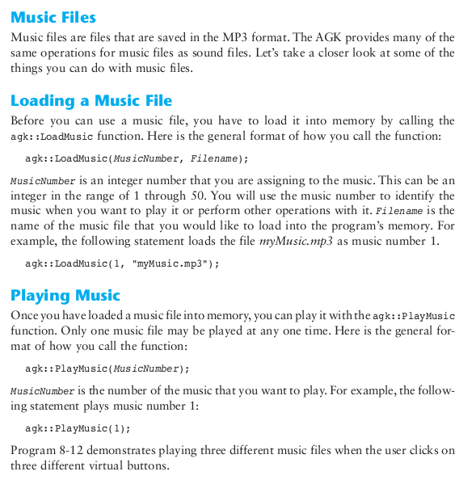

Slide 14
// This program demonstrates playing music
// when a virtual button is clicked by the mouse.
// Includes, namespace and prototypes
#include "template.h"
using namespace AGK;
app App;
// Begin app, called once at the start
void app::Begin( void )
{
// Set the window title.
agk::SetWindowTitle("Music Player");
// Set the virtual resolution.
agk::SetVirtualResolution(640, 480);
// Load the music files.
agk::LoadMusic(1, "MusicA.mp3");
agk::LoadMusic(2, "MusicB.mp3");
agk::LoadMusic(3, "MusicC.mp3");
// Add the virtual buttons.
agk::AddVirtualButton(1, 220, 240, 100);
agk::AddVirtualButton(2, 320, 240, 100);
agk::AddVirtualButton(3, 420, 240, 100);
// Set the text for the virtual buttons.
agk::SetVirtualButtonText(1, "1");
agk::SetVirtualButtonText(2, "2");
agk::SetVirtualButtonText(3, "3");
}
// Main loop, called every frame
void app::Loop ( void )
{
// If button 1 was pressed, play music 1.
if(agk::GetVirtualButtonPressed(1))
{ agk::PlayMusic(1);
}
// If button 2 was pressed, play music 2.
if(agk::GetVirtualButtonPressed(2))
{ agk::PlayMusic(2); }
// If button 3 was pressed, play music 3.
if(agk::GetVirtualButtonPressed(3))
{ agk::PlayMusic(3); }
// Refresh the screen.
agk::Sync(); }
// Called when the app ends
void app::End ( void )
{
}

Slide 15
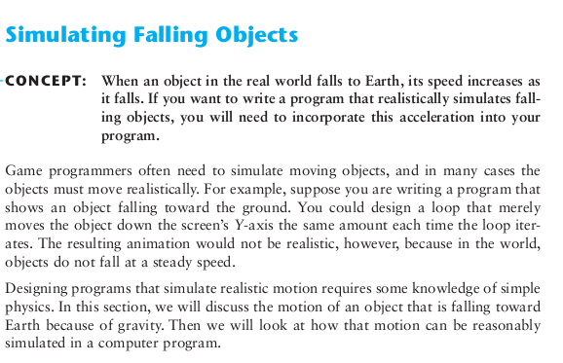
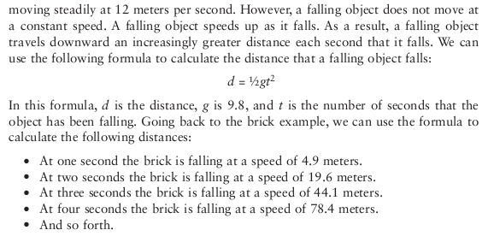

Slide 16
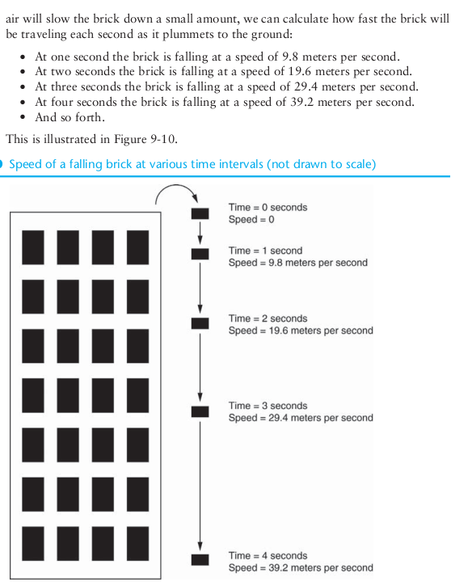

Slide 17
FreeFall.cpp and ball.png in the gDrive
// This program simulates a falling ball.
// Includes, namespace and prototypes
#include "template.h"
using namespace AGK;
app App;
// Global Constants
const int SCREEN_WIDTH = 640;
const int SCREEN_HEIGHT = 480;
const int BALL_IMAGE = 1;
const int BALL_SPRITE = 1;
const float ACCELERATION = 0.98;
// Global variables
float g_time = 0;
float g_distance = 0;
// Begin app, called once at the start
void app::Begin( void ) {
// Set the virtual resolution.
agk::SetVirtualResolution(SCREEN_WIDTH, SCREEN_HEIGHT);
// Set the window title.
agk::SetWindowTitle("Free Fall");
// Load the ball image.
agk::LoadImage(BALL_IMAGE, "ball.png");
// Create the ball sprite.
agk::CreateSprite(BALL_SPRITE, BALL_IMAGE);
// Set the starting position of the ball sprite.
agk::SetSpriteX(BALL_SPRITE, SCREEN_WIDTH / 2 -
agk::GetSpriteWidth(BALL_SPRITE) / 2);
}
// Main loop, called every frame
void app::Loop ( void ) {
// Get the Y-coordinate of the ball sprite.
float y = agk::GetSpriteY(BALL_SPRITE);
// If the ball is above the bottom of the screen,
// then update its position.
if (y < SCREEN_HEIGHT - agk::GetSpriteHeight(BALL_SPRITE))
{
// Calculate the object's distance using the
// distance formula.
g_distance = 0.5 * ACCELERATION * g_time * g_time;
// Set the Y-coordinate of the ball sprite to
// the distance.
y = g_distance;
// Increment time.
g_time++;
}
// Else, set the Y-coordinate of the ball sprite at
// the bottom of the screen.
else
{
y = SCREEN_HEIGHT - agk::GetSpriteHeight(BALL_SPRITE);
}
// Update the Y-coordinate of the ball sprite.
agk::SetSpriteY(BALL_SPRITE, y);
// Refresh the screen.
agk::Sync();
}
// Called when the app ends
void app::End ( void )
{
}
// Else, set the Y-coordinate of the ball sprite at
// the bottom of the screen.
else
{
y = SCREEN_HEIGHT - agk::GetSpriteHeight(BALL_SPRITE);
}
// Update the Y-coordinate of the ball sprite.
agk::SetSpriteY(BALL_SPRITE, y);
// Refresh the screen.
agk::Sync();
}
// Called when the app ends
void app::End ( void )
{
}

Slide 18
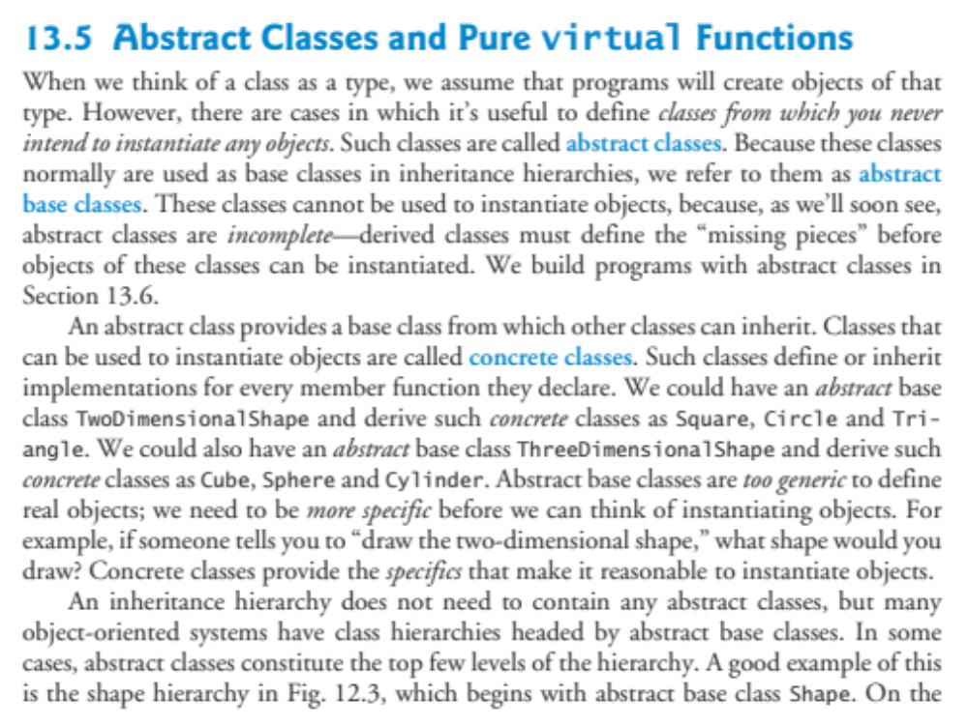

Slide 19
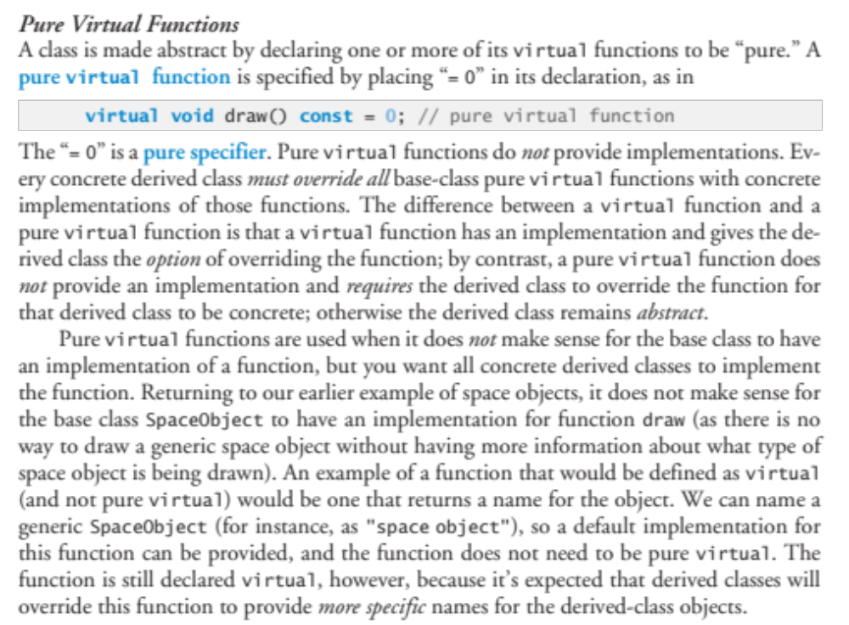

Slide 20
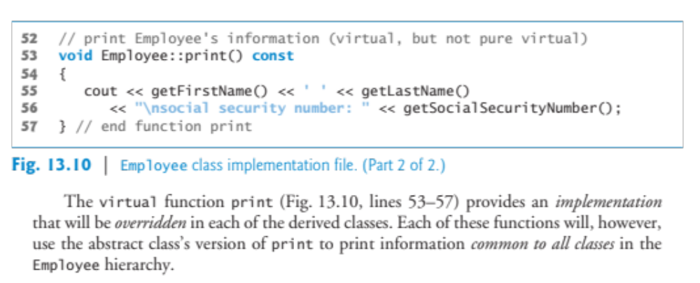
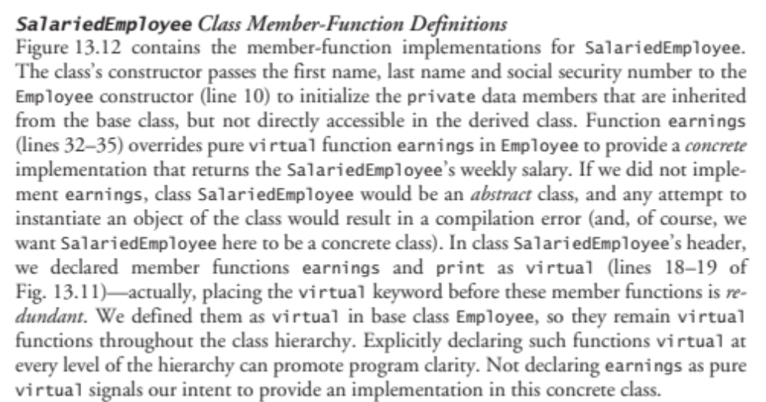

Slide 21
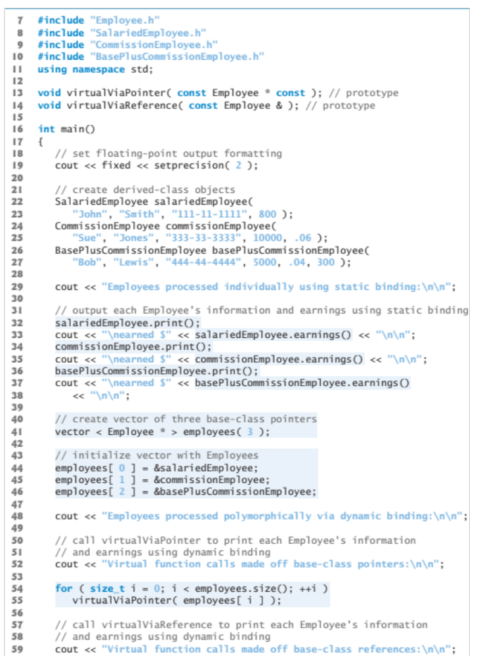

Slide 22
